Slide 1


Jainish Patel
1/5/2023

Slide 2

Outline
Executive Summary
Introduction
Methodology
Results
Conclusion
Appendix

Slide 3
Executive Summary
Summary of Methodologies:
Data Collection API
Data Collection with Web Scrapping
Data Wrangling
EDA with SQL
EDA with Visualization
Visual Analytics with Folium
Dashboard using Plotly
Prediction using Machine Learning
Summary of Results:
Exploratory Data Analysis Results
Predictive Analysis Results

Slide 4
Introduction
Project background and context:
SpaceX a rocket company launches satellites at low price like 70% less than their competitor since they land their satellites for reusing them to launch.
Problems you want to find answers:
We use the previous data of launches of Falcon 9 rocket to predict the probability of the booster landing back to the pad influenced/correlated with the space launch site, the payload orbit, mass, landing pad location and the version of the booster.

Slide 5

Section 1

Slide 6
Methodology
Executive Summary
Data collection methodology:
SpaceX Rest API
Perform data wrangling:
Web Scrapping from Wikipedia
Perform exploratory data analysis (EDA) using visualization and SQL
Perform interactive visual analytics using Folium and Plotly Dash
Perform predictive analysis using classification models
LR, KNN, SVM models have been built and evaluated for best classifier

Slide 7
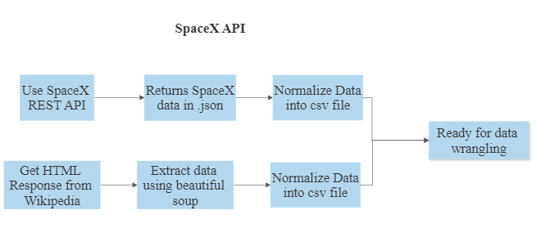
Data Collection
REST API :
Using the REST API we extract the data in form of JSON and transform it to a dataframe using inbuilt python pandas method normalize .
WEB SCRAPING :
Web scraping SpaceX launches from Wikipedia and converting it into a dataframe.

Slide 8
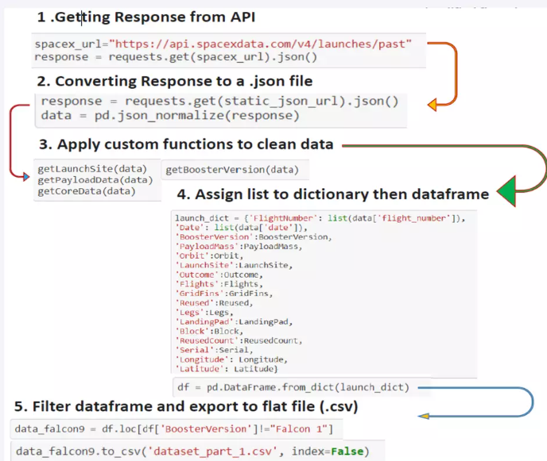
Data Collection – SpaceX API
SpaceX launch data that is gathered from the SpaceX REST API.
This API will give us data about launches, including information about the rocket used, payload delivered, launch specifications, landing specifications and landing outcomes.
GitHub: https://github.com/Jainish1019/Applied_Data_Science/blob/master/Data%20Collection%20API-1.ipynb

Slide 9
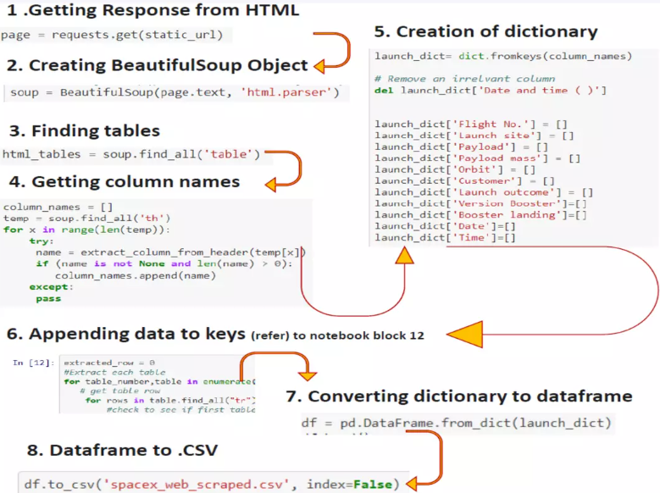
Data Collection - Scraping
In the data set, there are several different cases where the booster did not land successfully.
GitHub: https://github.com/Jainish1019/Applied_Data_Science/blob/master/Data%20Collection%20with%20Web%20Scraping.ipynb

Slide 10
Data Wrangling
In the data set, there are several different cases where the booster did not land successfully.
Sometimes a landing was attempted but failed due to an accident; for example, True Ocean means the mission outcome was successfully landed to a specific region of the ocean while False Ocean means the mission outcome was unsuccessfully landed to a specific region of the ocean. True RTLS means the mission outcome was successfully landed to a ground pad False RTLS means the mission outcome was unsuccessfully landed to a ground pad.
True ASDS means the mission outcome was successfully landed on a drone ship False ASDS means the mission outcome was unsuccessfully landed on a drone ship.
GitHub: https://github.com/Jainish1019/Applied_Data_Science/blob/master/Data%20Wragling.ipynb

Slide 11
EDA with Data Visualization
Graphs used:
Scatter Plot
Bar Chart
Line Chart
Because they are the once that best highlight the relationship between variables considered.
GitHub: https://github.com/Jainish1019/Applied_Data_Science/blob/master/EDA%20with%20Visualization.ipynb

Slide 12
EDA with SQL
Display the names of the unique launch sites in the space mission.
Display 5 records where launch sites begin with the string 'CCA’.
Display the total payload mass carried by boosters launched by NASA (CRS).
Display average payload mass carried by booster version F9 v1.1.
List the date when the first successful landing outcome in the ground pad was achieved.
List the names of the boosters which have success in drone ship and have payload mass greater than 4000 but less than 6000.
List of total number of successful and failure mission outcomes.
List the names of the booster_versions which have carried the maximum payload mass.
List the failed landing_outcomes in drone ship, their booster versions, and launch site names for in year 2015.
GitHub: https://github.com/Jainish1019/Applied_Data_Science/blob/master/EDA%20with%20SQL.ipynb

Slide 13
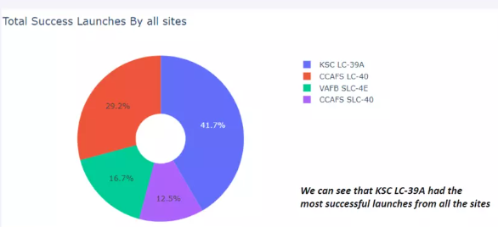
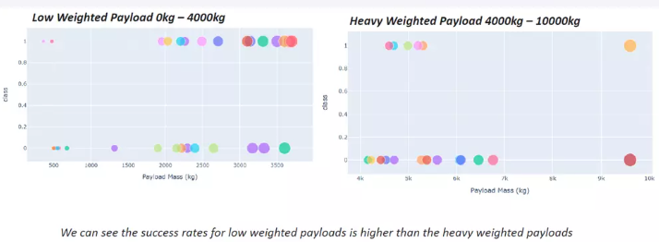
Build an Interactive Map with Folium
Summary of map objects:
Markers: Show a geo location from latitude and longitude data
Cluster: Show a group of markers
Circles: Show a single location
Lines: Show distance between two I have added object to find some geographical patterns about launch site
GitHub: https://github.com/Jainish1019/Applied_Data_Science/blob/master/Interactive%20Visual%20Analytics%20with%20Folium.ipynb

Slide 14
Build a Dashboard with Plotly Dash
Summary of plots:
Bar: Show categories differences
Line: Reports time series changes
Pie: Shows the percentage of events
Tree: Shows complex relationship of variables in interactive way
Map: Shows variables of states on a map
GitHub: https://github.com/Jainish1019/Applied_Data_Science/blob/master/spacex_dash_app.py

Slide 15
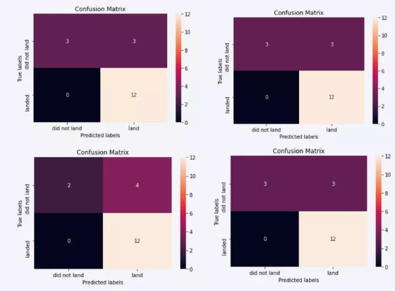
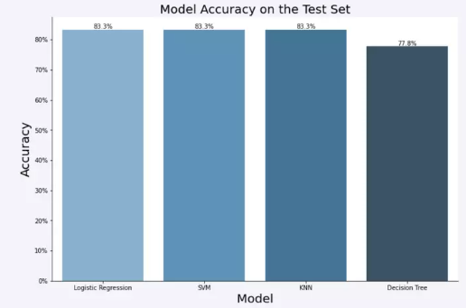
Predictive Analysis (Classification)
The SVM, KNN, and Logistic Regression model achieved the highest accuracy at 83.3%, while the SVM performs the best in terms of Area Under the Curve at 0.958.

Slide 16
Results
Exploratory data analysis results
Both API and web scraping are capable to collect SpaceX data.
Interactive analytics demo in screenshots
EDA with SQL is effective for data filtering
EDA with interactive visualization provides informative information
Plotly Dash is powerful to show instant data change •
Predictive analysis results
Decision Tree Classifier Algorithm has the best accuracy of predicting

Slide 17

Section 2

Slide 18
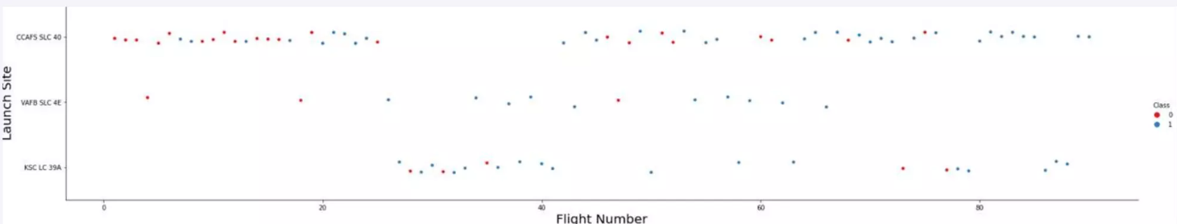
Flight Number vs. Launch Site
Launches from the site of CCAFS SLC 40 are significantly higher than any other.

Slide 19
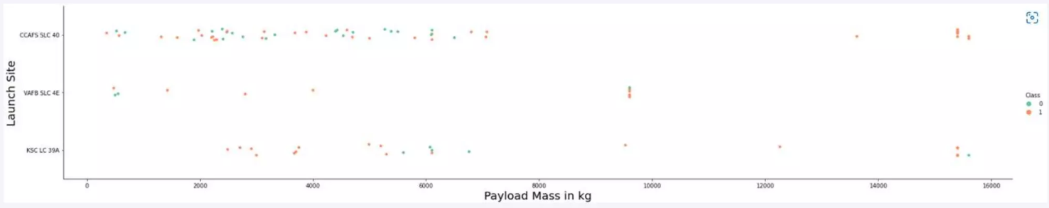
Payload vs. Launch Site
The majority of Pay Loads with lower Mass have been launched from CCAFS SLC 40.

Slide 20
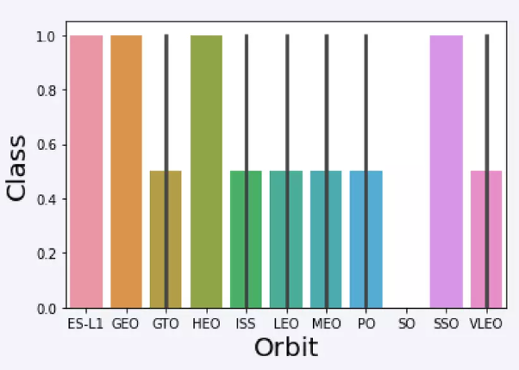
Success Rate vs. Orbit Type
We can see the orbits with the highest success rate are : SSO, HEO, GEO, ES-L1.
While the GTO Orbit it is the one with lowest rate

Slide 21
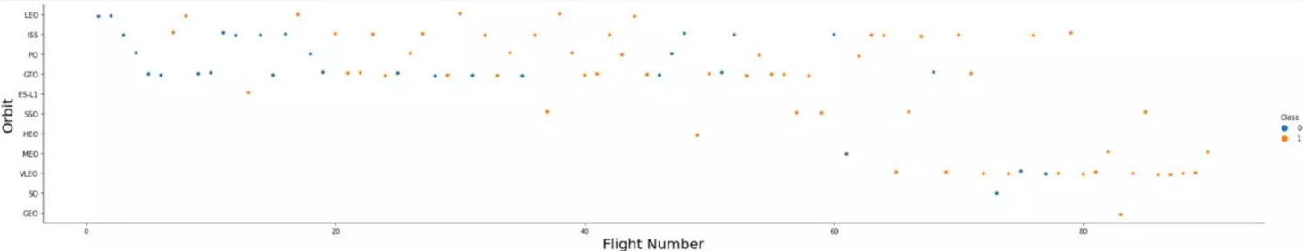
Flight Number vs. Orbit Type
You should see that in the LEO orbit the Success appears related to the number of flights.
On the other hand, there seems to be no relationship between flight number when in GTO orbit.

Slide 22
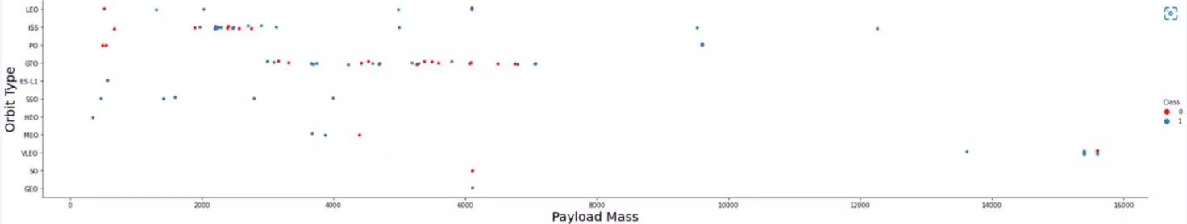
Payload vs. Orbit Type
You should observe that Heavy payloads have a negative influence on GTO orbits and positive on GTO and Polar LEO (ISS) orbits.

Slide 23
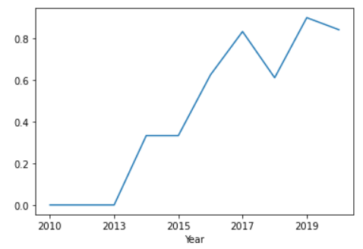
Launch Success Yearly Trend
Launch success rate has increased significantly since 2013 and has establised since 2019, potentially due to advance in technology and lessons learned.

Slide 24
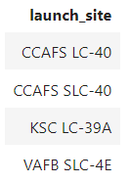
All Launch Site Names
%sql select DISTINCT Launch_Site from SPACEX

Slide 25
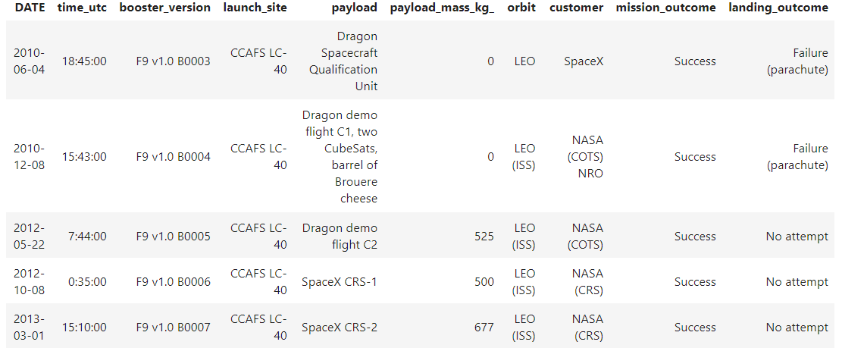
Launch Site Names Begin with 'CCA'
%sql select * from SPACEX where Launch_Site like 'CCA%' limit 5

Slide 26
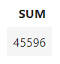
Total Payload Mass
%sql select sum(PAYLOAD_MASS_KG_) as sum from SPACEX where customer like 'NASA (CRS)'

Slide 27
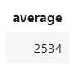
Average Payload Mass by F9 v1.1
%sql select avg(PAYLOAD_MASS_KG_) as Average from SPACEX where Booster_Version like 'F9 v1.1%'

Slide 28
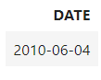
First Successful Ground Landing Date
%sql select min(date) as Date from SPACEX where Mission_Outcome like 'Success'

Slide 29
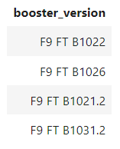
Successful Drone Ship Landing with Payload between 4000 and 6000
%sql select Booster_Version from SPACEX where (Mission_Outcome like 'Success') AND (PAYLOAD_MASS_KG_ between 4000 AND 6000)

Slide 30
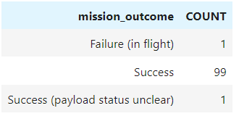
Total Number of Successful and Failure Mission Outcomes
%sql SELECT mission_outcome, count(*) as Count FROM SPACEX GROUP by mission_outcome ORDER BY mission_outcome

Slide 31
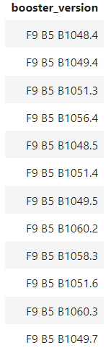
Boosters Carried Maximum Payload
maxm = %sql select max(payload_mass_kg_) from SPACEX
maxv = maxm[0][0]
%sql select booster_version from SPACEX where payload_mass_kg_ =(select max(payload_mass_kg_) from SPACEX)

Slide 32
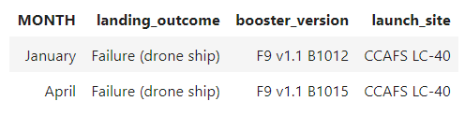
2015 Launch Records
%sql select * from SPACEX where Landing_Outcome like 'Success%' and (DATE between '2015-01-01' and '2015-12-31') order by date desc

Slide 33
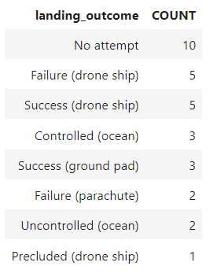
Rank Landing Outcomes Between 2010-06-04 and 2017-03-20
%%sql
select Landing_Outcome, count(*) as count from SPACEX
where Date >= '2010-06-04' AND Date <= '2017-03-20’
GROUP by Landing_Outcome ORDER BY count Desc

Slide 34

Section 3

Slide 35
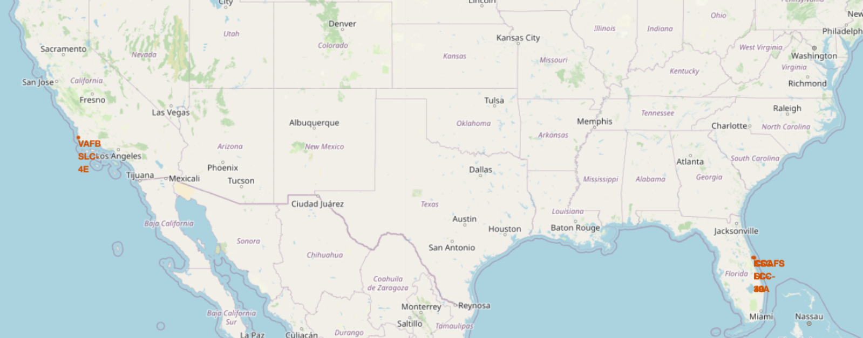
All launch sites on a map
Both ground and sea surface sites are necessary also south areas maybe a proper areas.
The transportation base chosen maybe important.

Slide 36
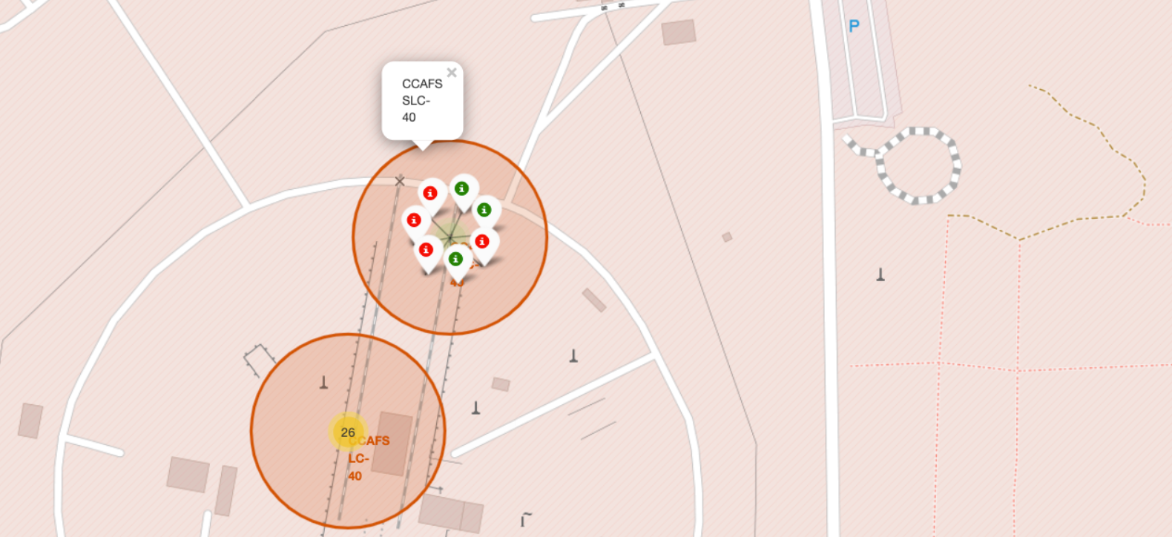
Success/Failed launches for each site on the map
Color icons are impressive way to show rate of success.
Here CCAFS SLC-40 shows approx. 43% success rate.

Slide 37
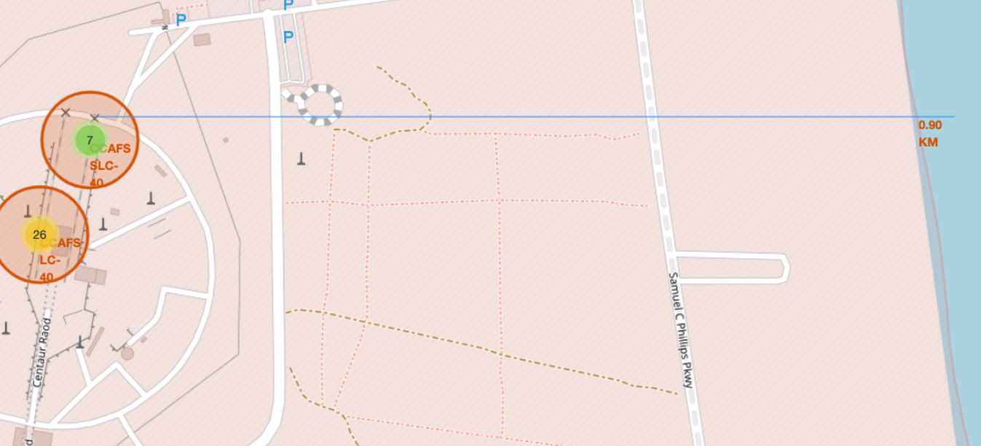
Distance between launch sites
This map shows the distance from point of interest.
In this case the distance from railway coast or port may be important.

Slide 38

Section 4

Slide 39
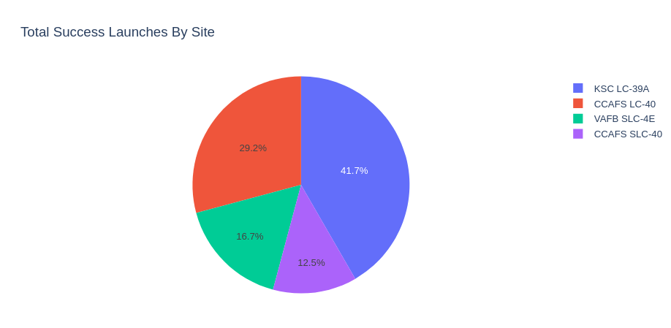
The most successful launch sites
We can see that CCAFS SLC-40 had the most successful launches from all the sites.

Slide 40
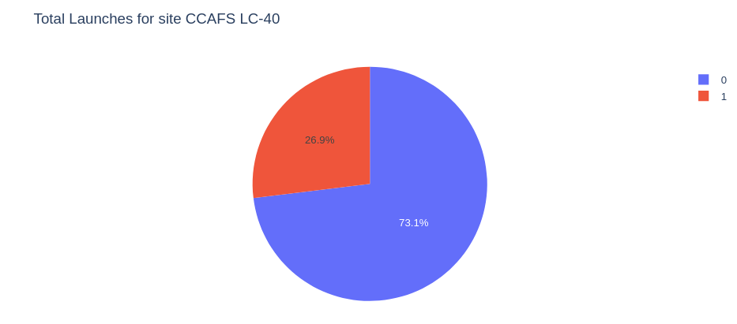
Success rate by site

Slide 41
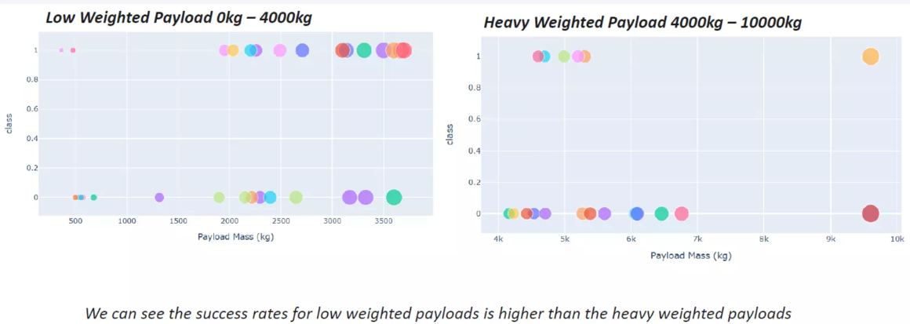
Payload and Success launch

Slide 42

Section 5

Slide 43
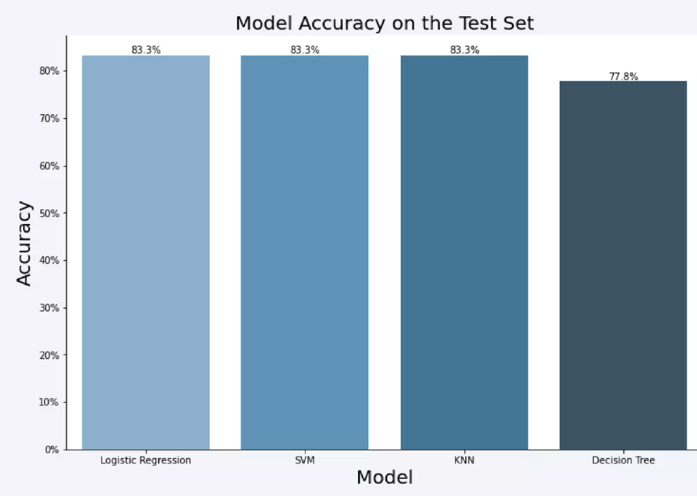
Classification Accuracy
As you can see our accuracy is extremely close.

Slide 44
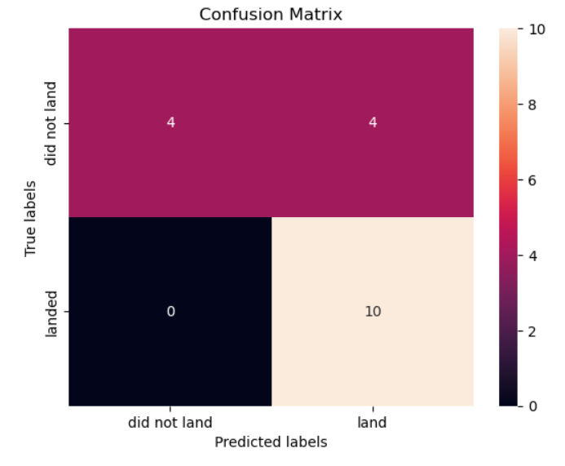
Confusion Matrix

Slide 45
Conclusions
The SVM, KNN, and Logistic Regression models are the best in terms of prediction accuracy for this dataset.
Low weighted payloads perform better than the heavier payloads.
The success rates for SpaceX launches is directly proportional time in years they will eventually perfect the launches.
KSC LC 39A had the most successful launches from all the sites.
Orbit GEO,HEO,SSO, ES L1 has the best Success Rate.

Slide 46


